Slide 1


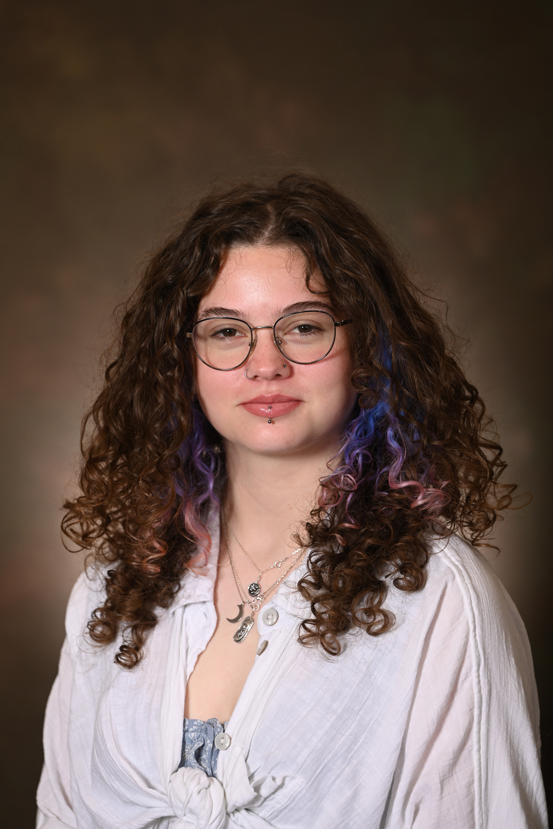

Megan Allen
FECDC Scholarship

Slide 2

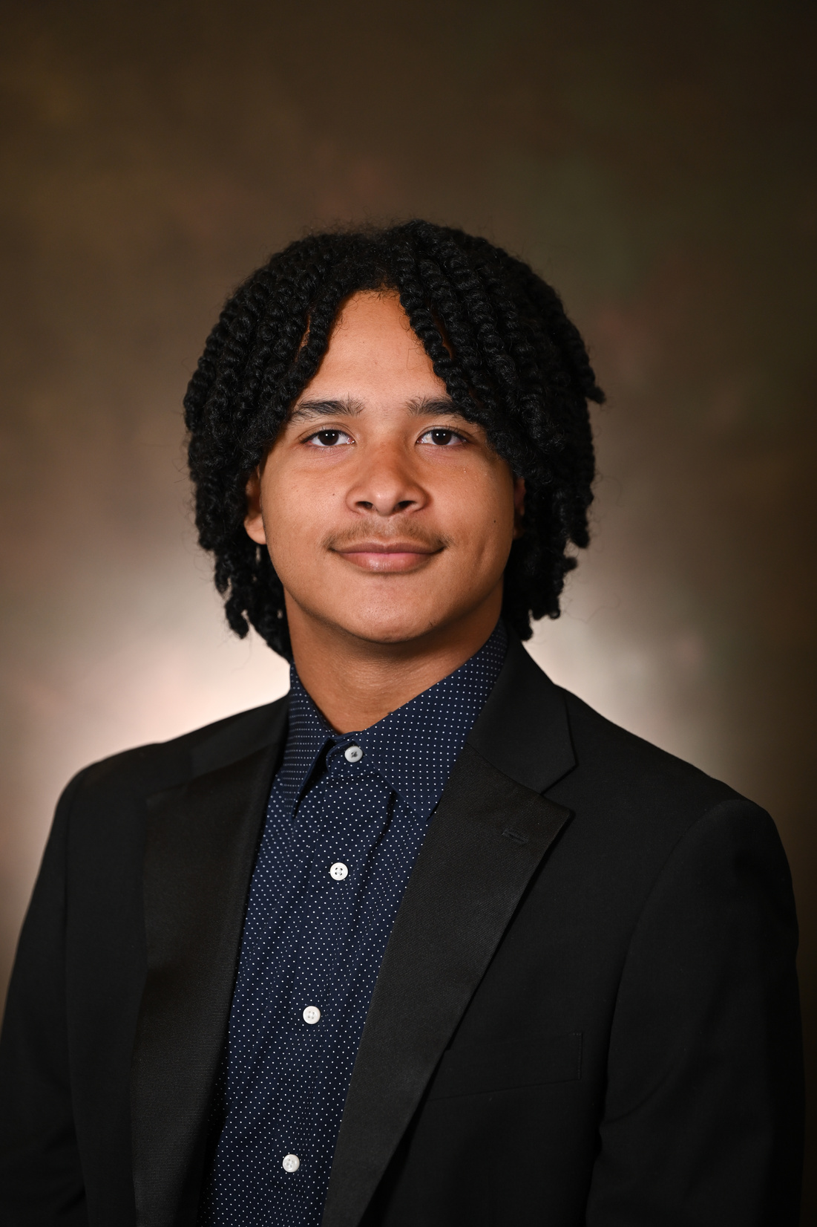
Jerry Clay, III
Johnson & Freeman Scholarship

Slide 3

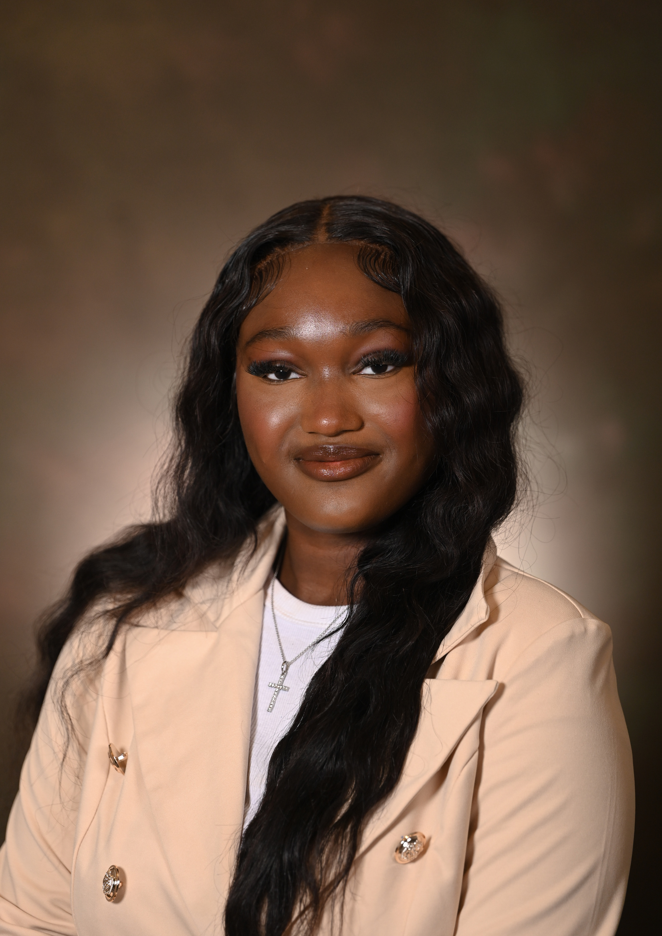
Bianca Egwu
Powered by Zerret Scholarship

Slide 4
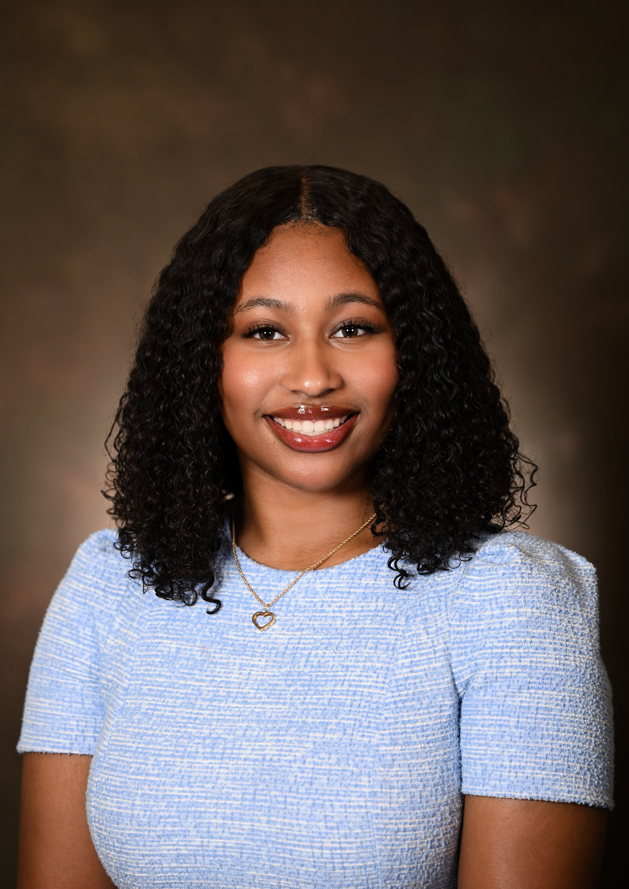
Kayla Elder
Kidcare Pediatrics/We Care Pediatrics and Adolescent Group Scholarship

Slide 5
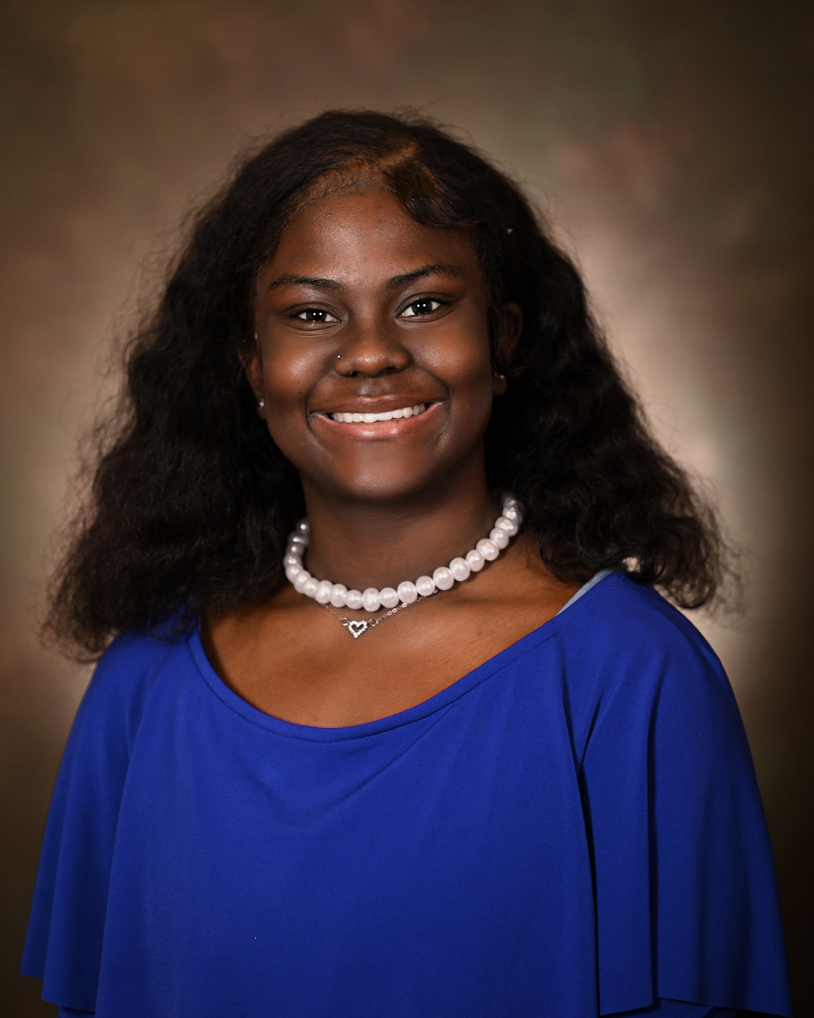
London Gaston
Barbara Bigelow
Memorial Scholarship

Slide 6
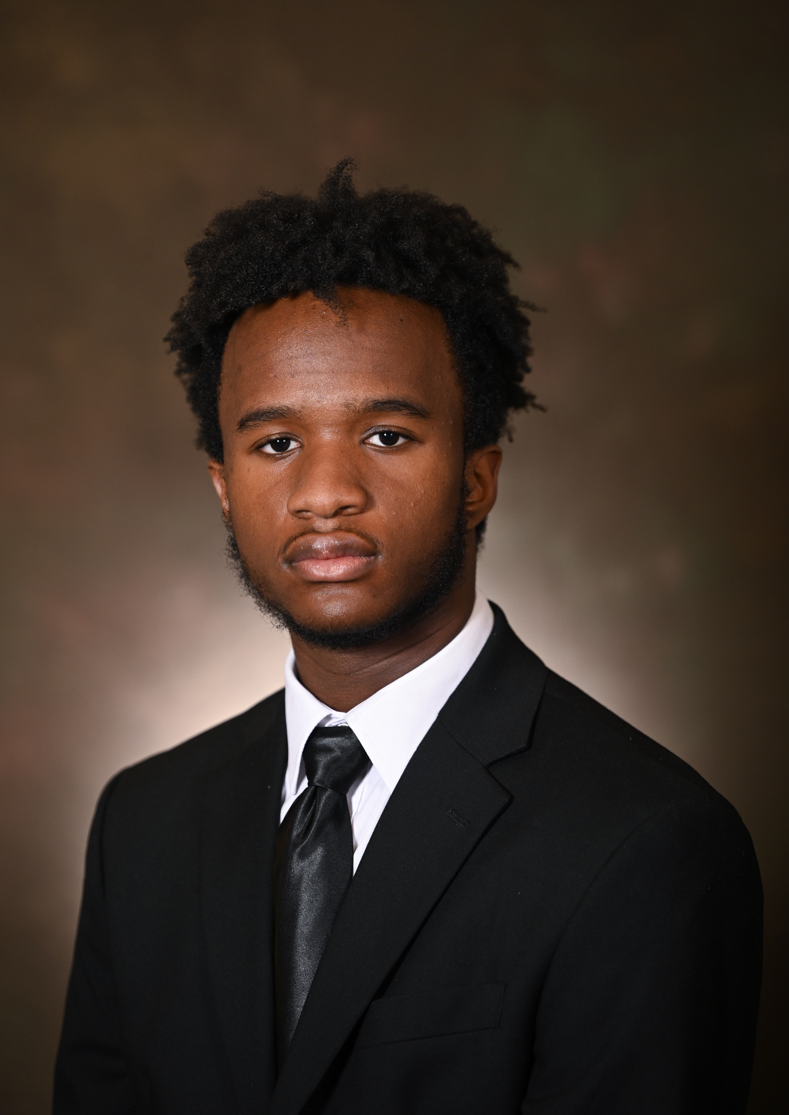
Niles Holt
P.A.M.M. Scholarship

Slide 7
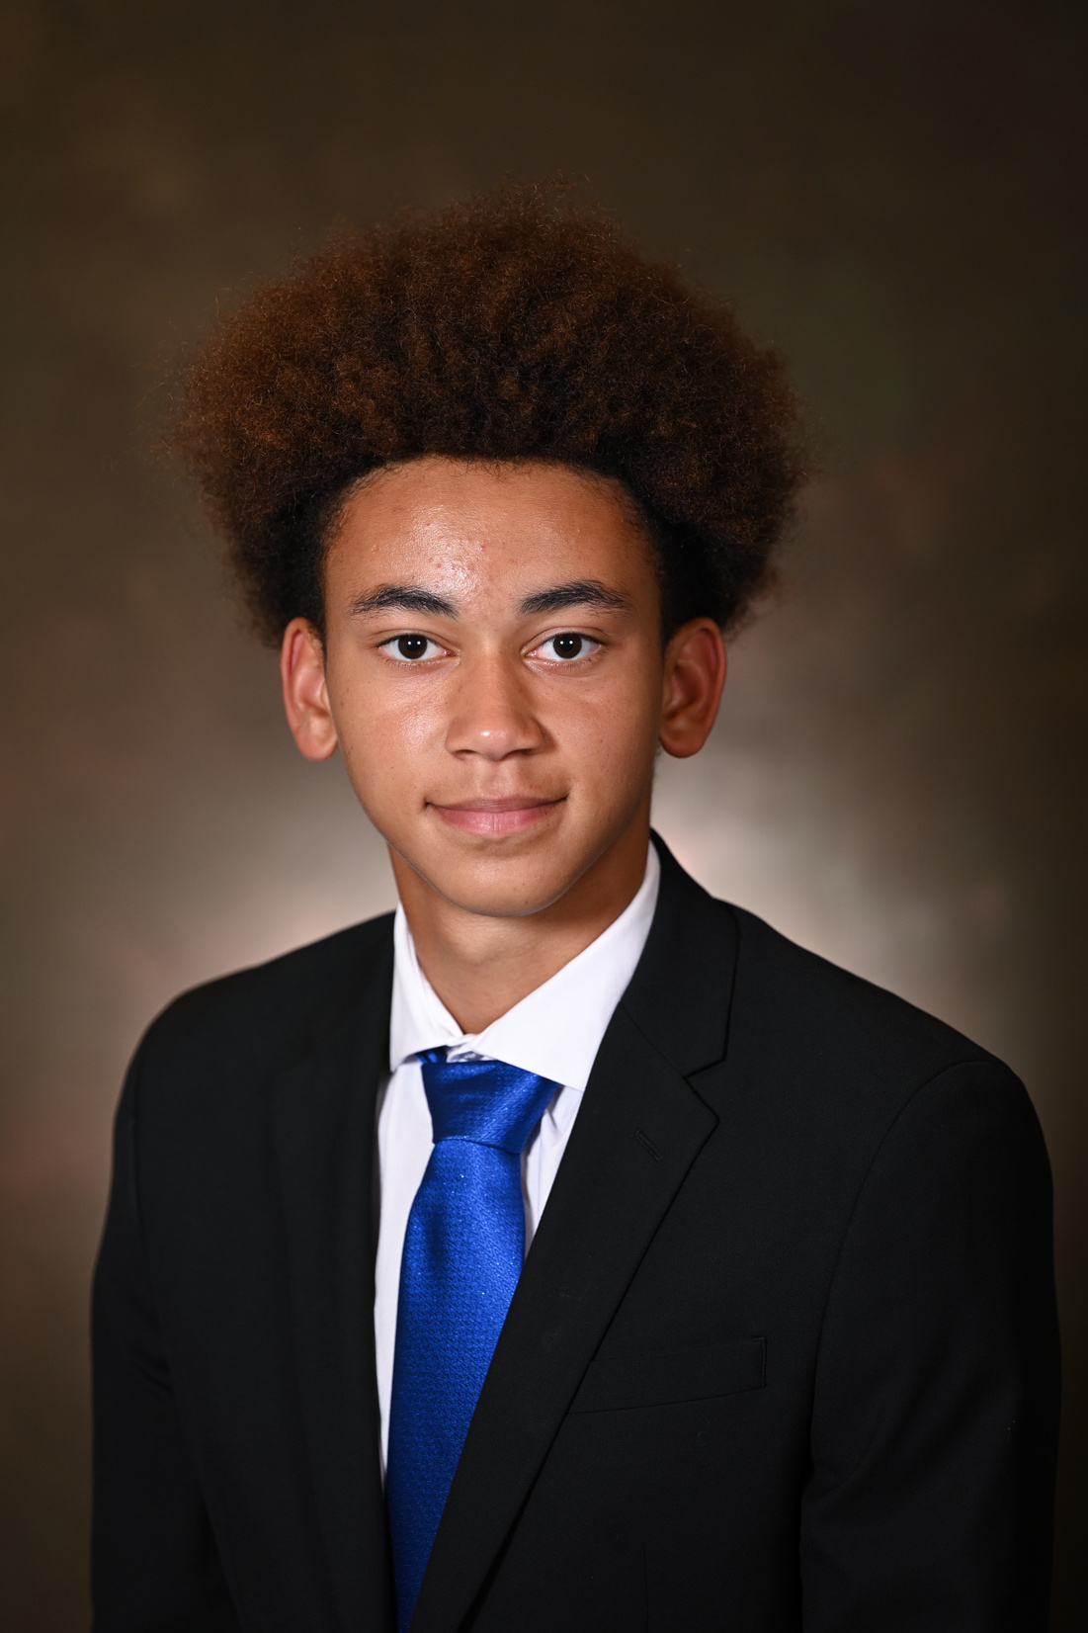
Gabriel Mawanda
Pota Estel Coston Memorial Scholarship

Slide 8
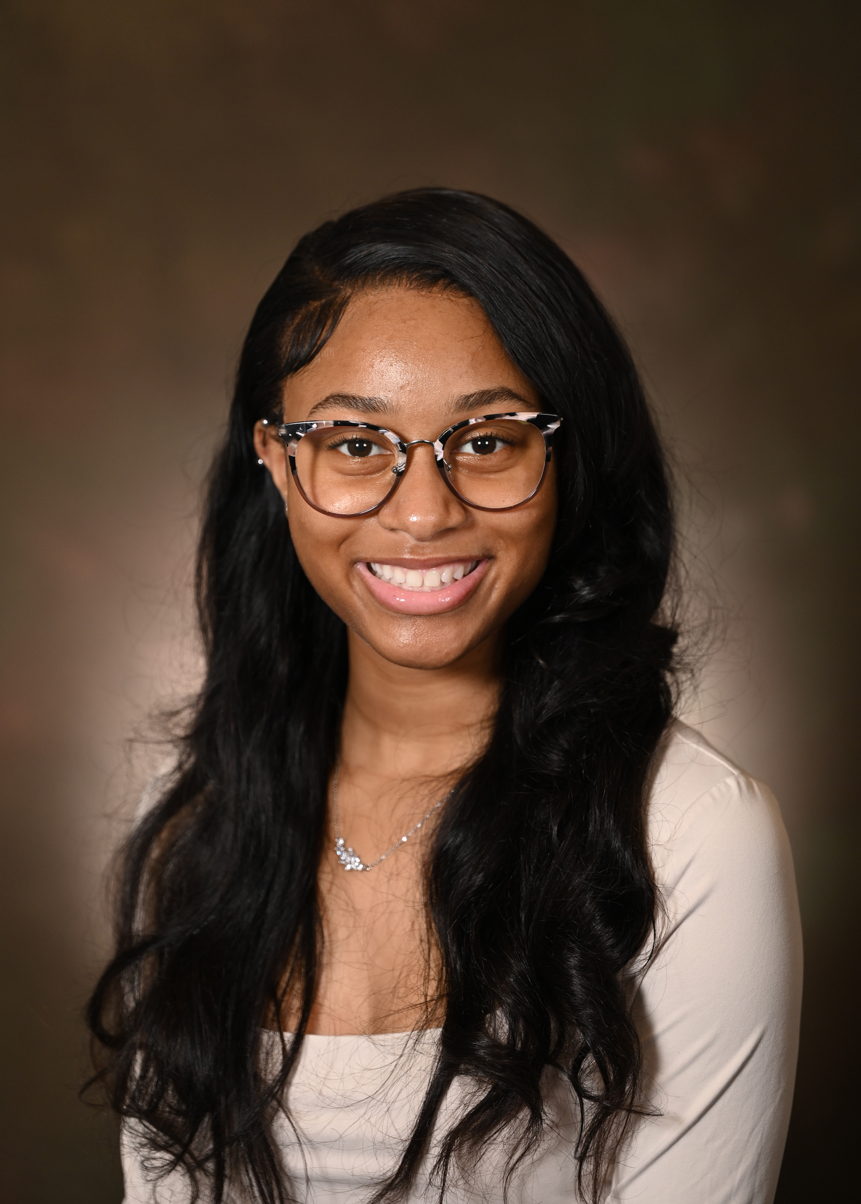
Julissa Reese
Harvey Newton Memorial Scholarship

Slide 9
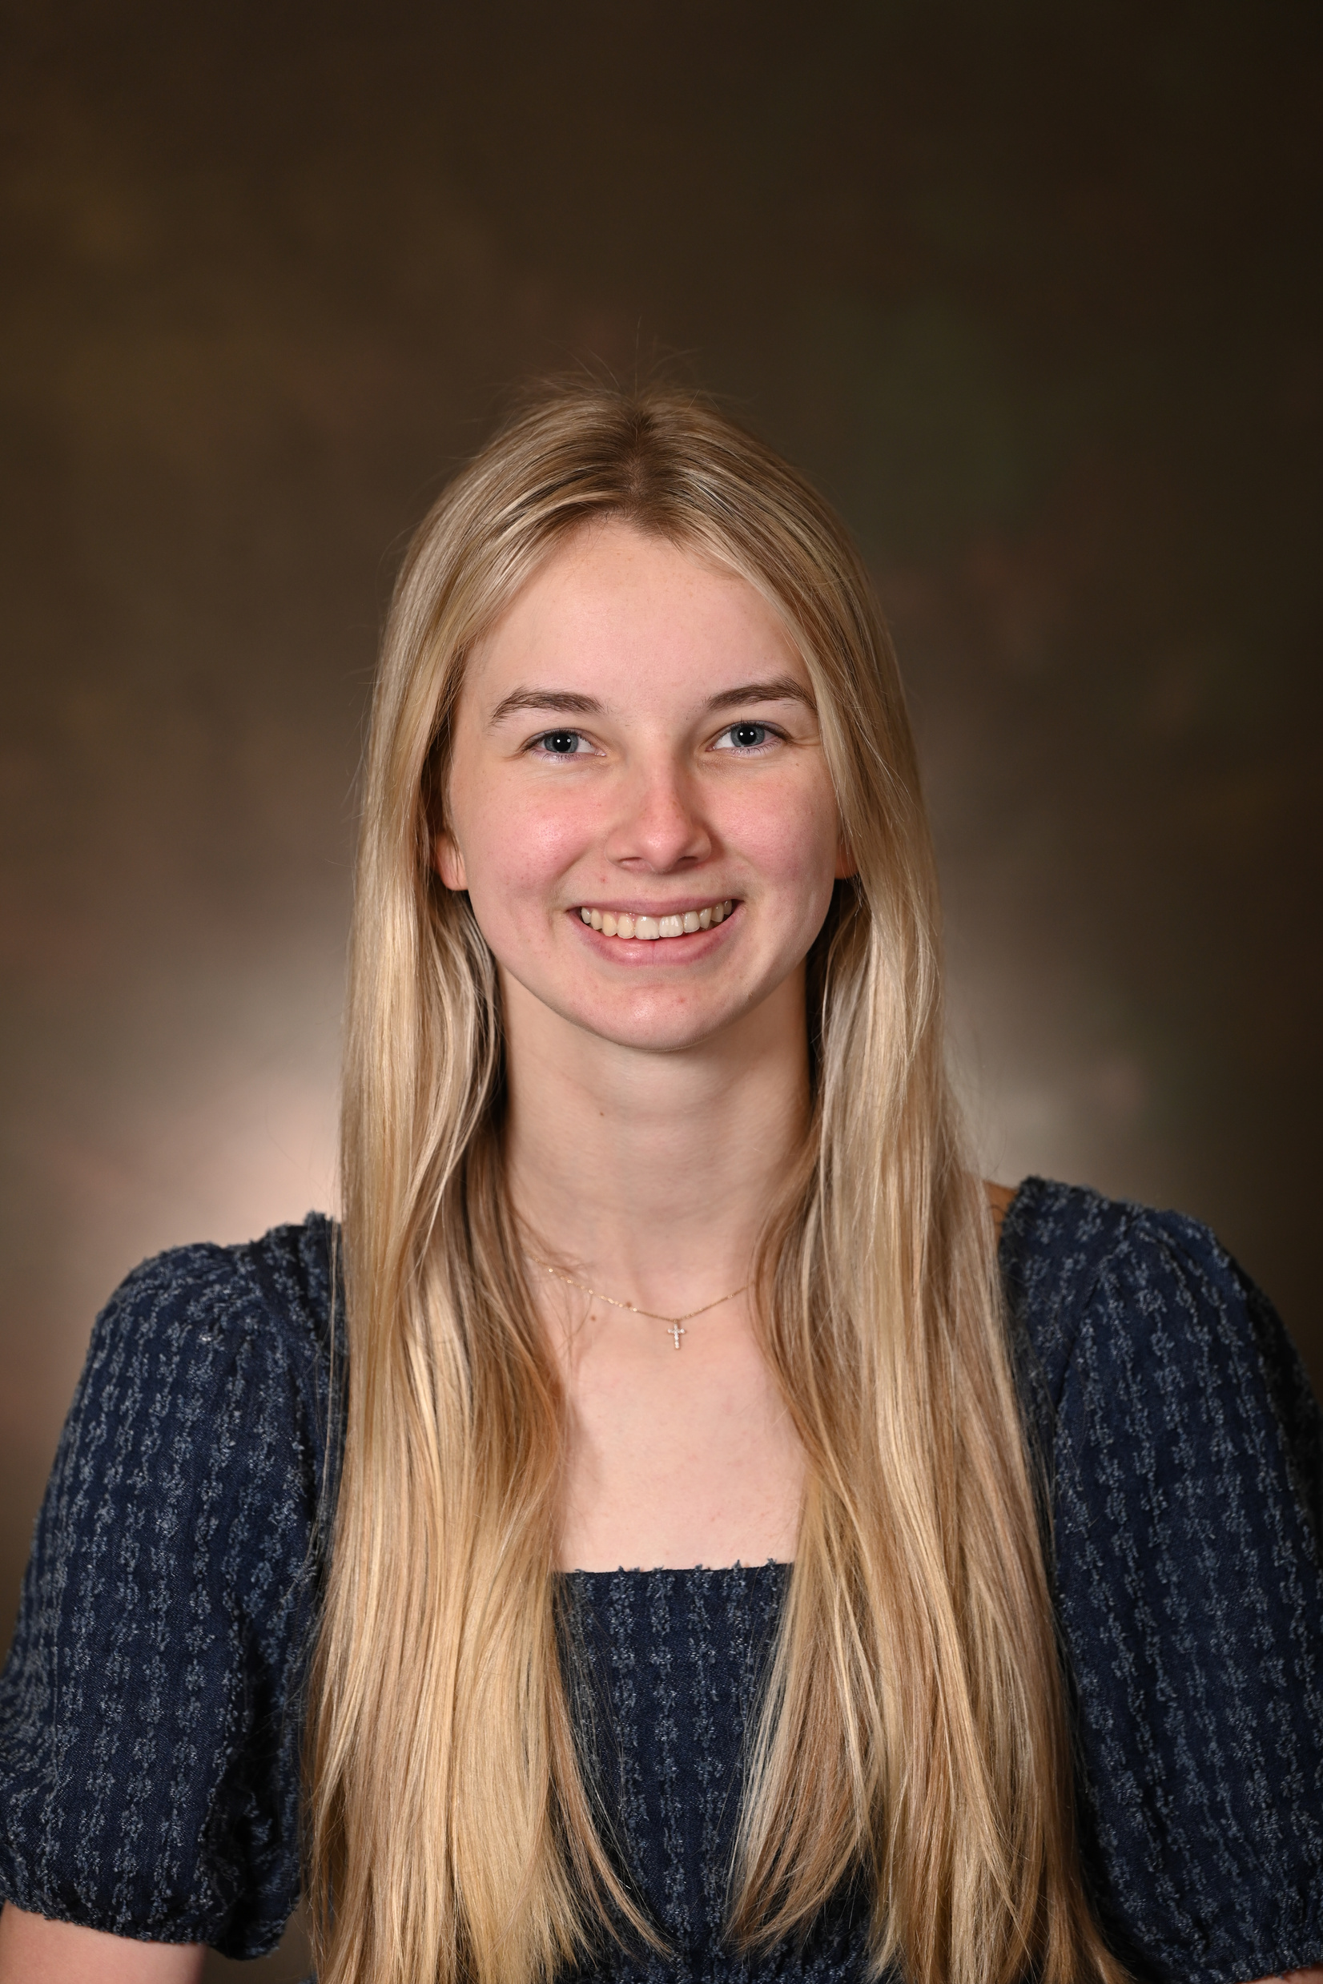
Campbell Richey
Johnson Family Scholarship

Slide 10
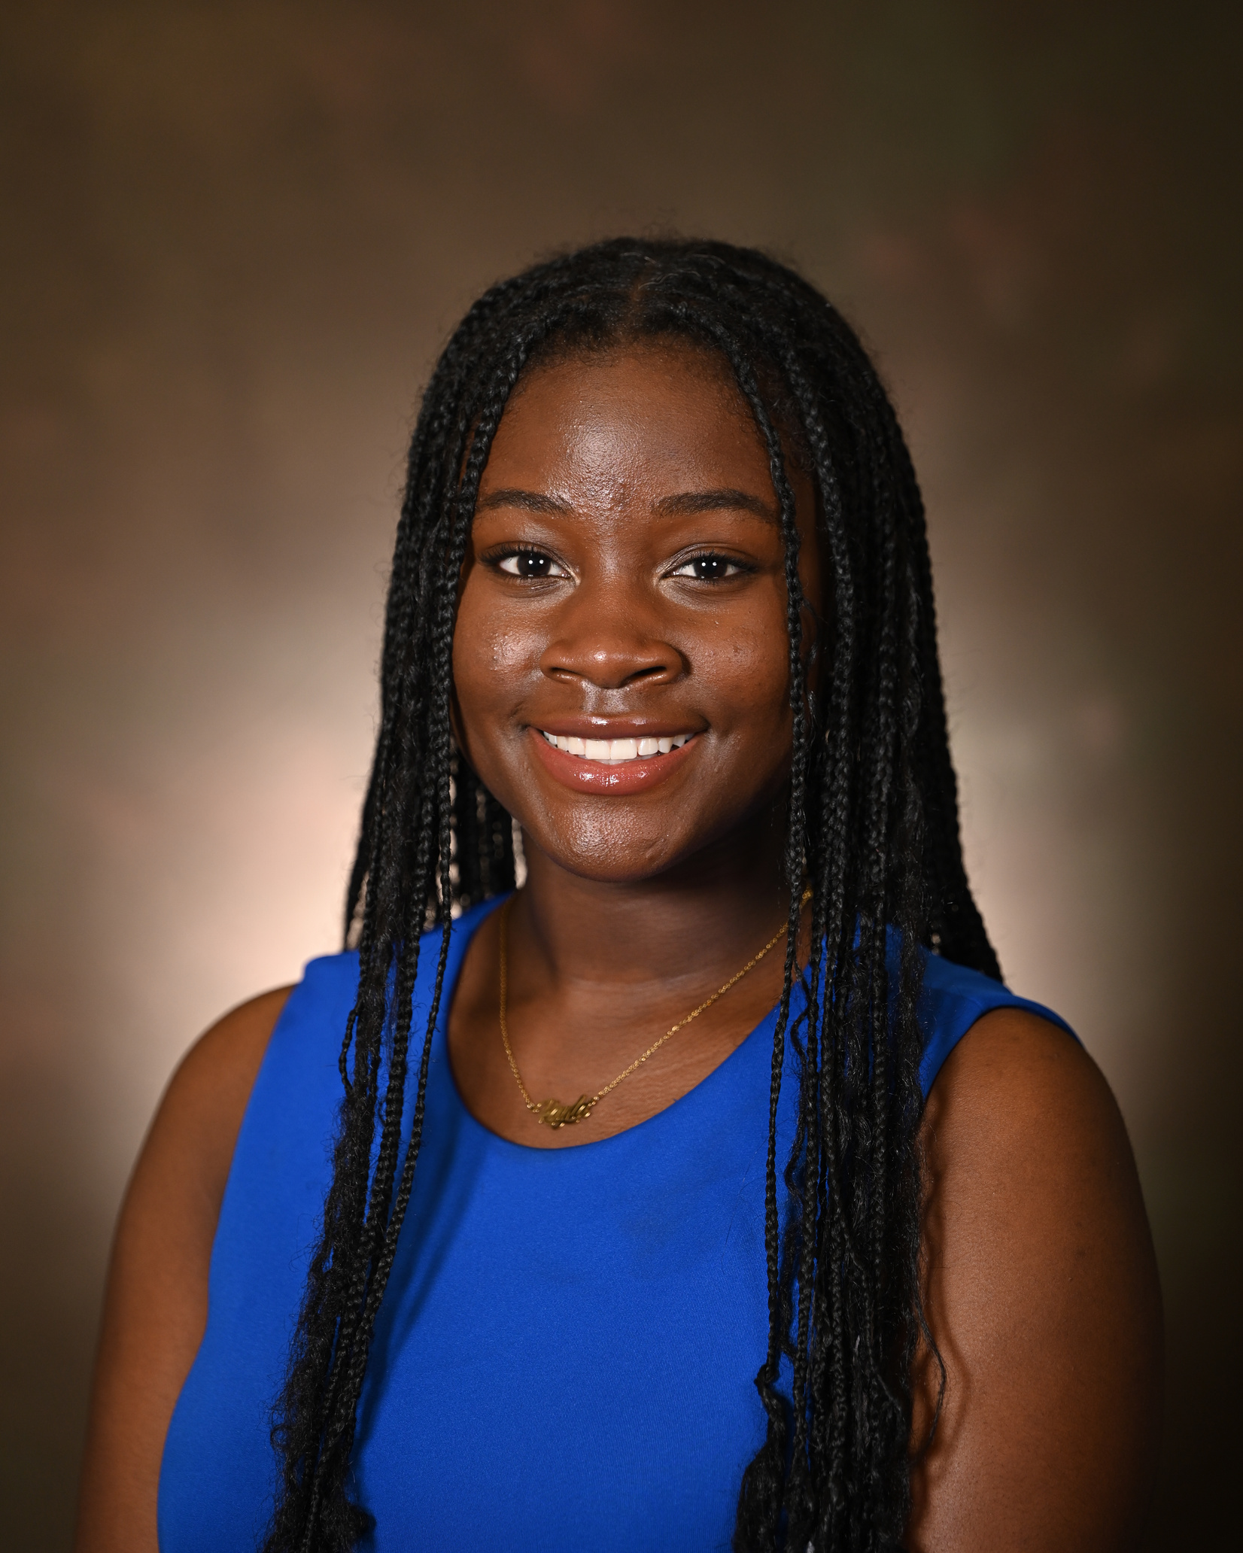
Kayla Ssendagire
East Point/College Park Alumnae Chapter
Delta Sigma Theta Sorority Inc. Scholarship

Slide 11
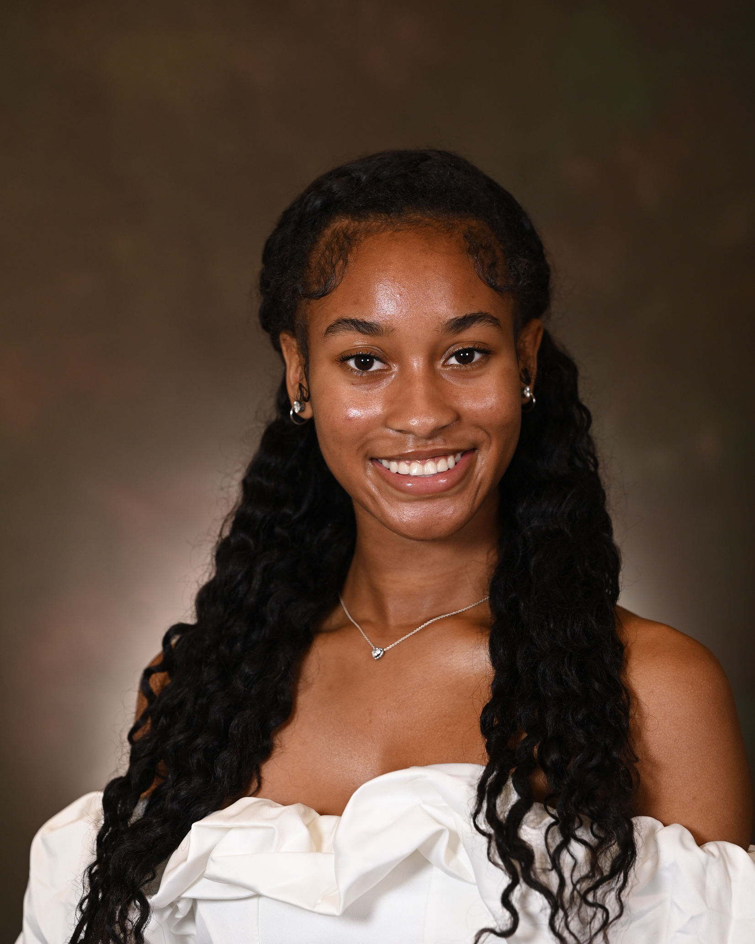
Jordyn White
Barbara Bigelow Memorial Scholarship

Slide 12
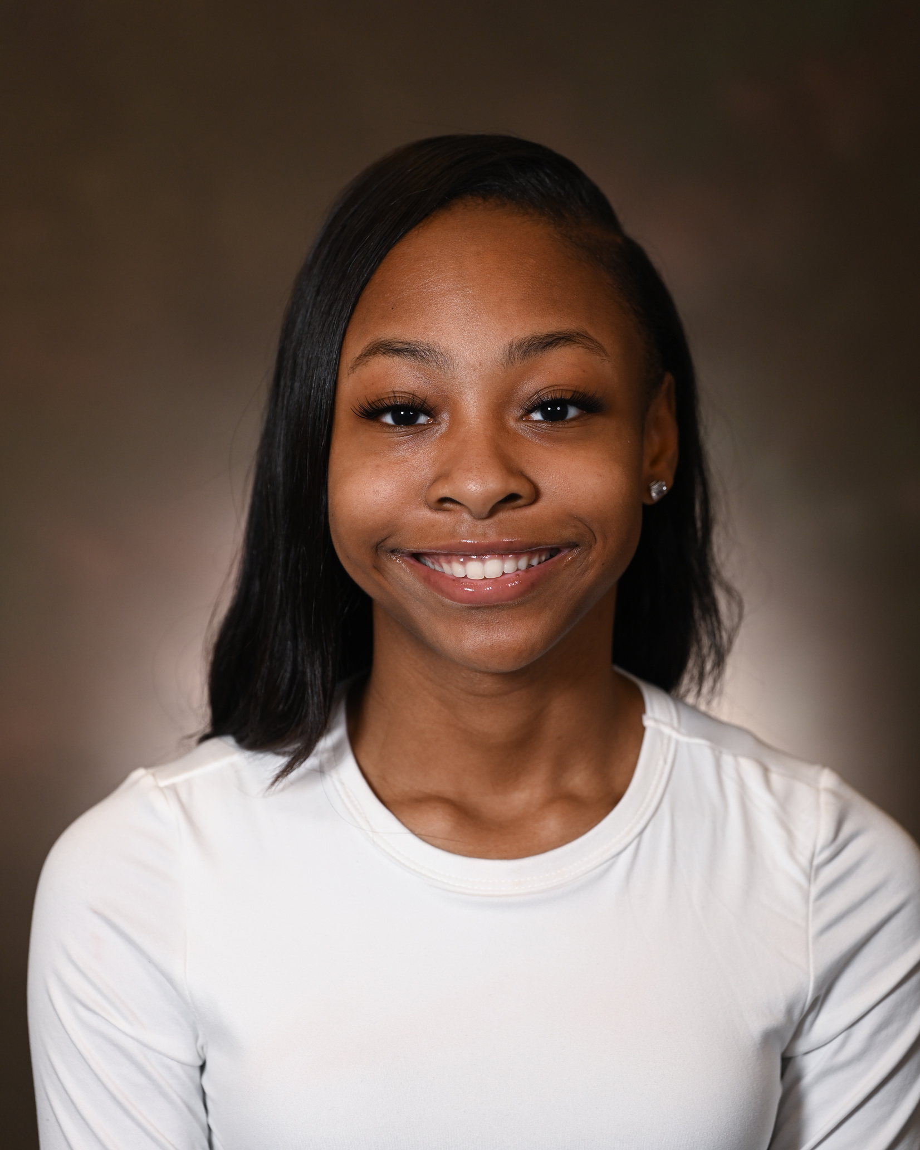
Taylor Williams
Pota Estel Coston
Memorial Scholarship

Slide 13
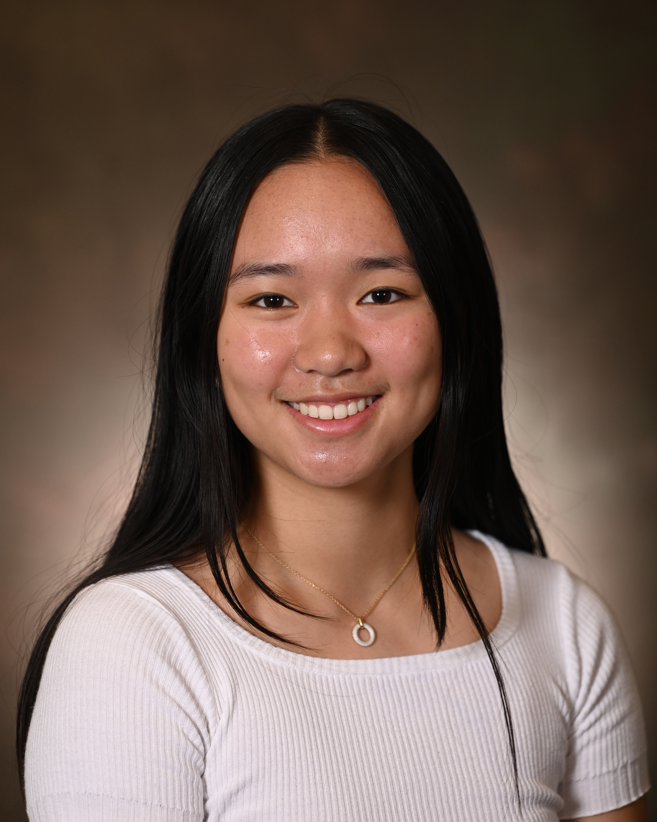
Isabel Yang
Robert J. Holmes Memorial Scholarship

